Slide 1
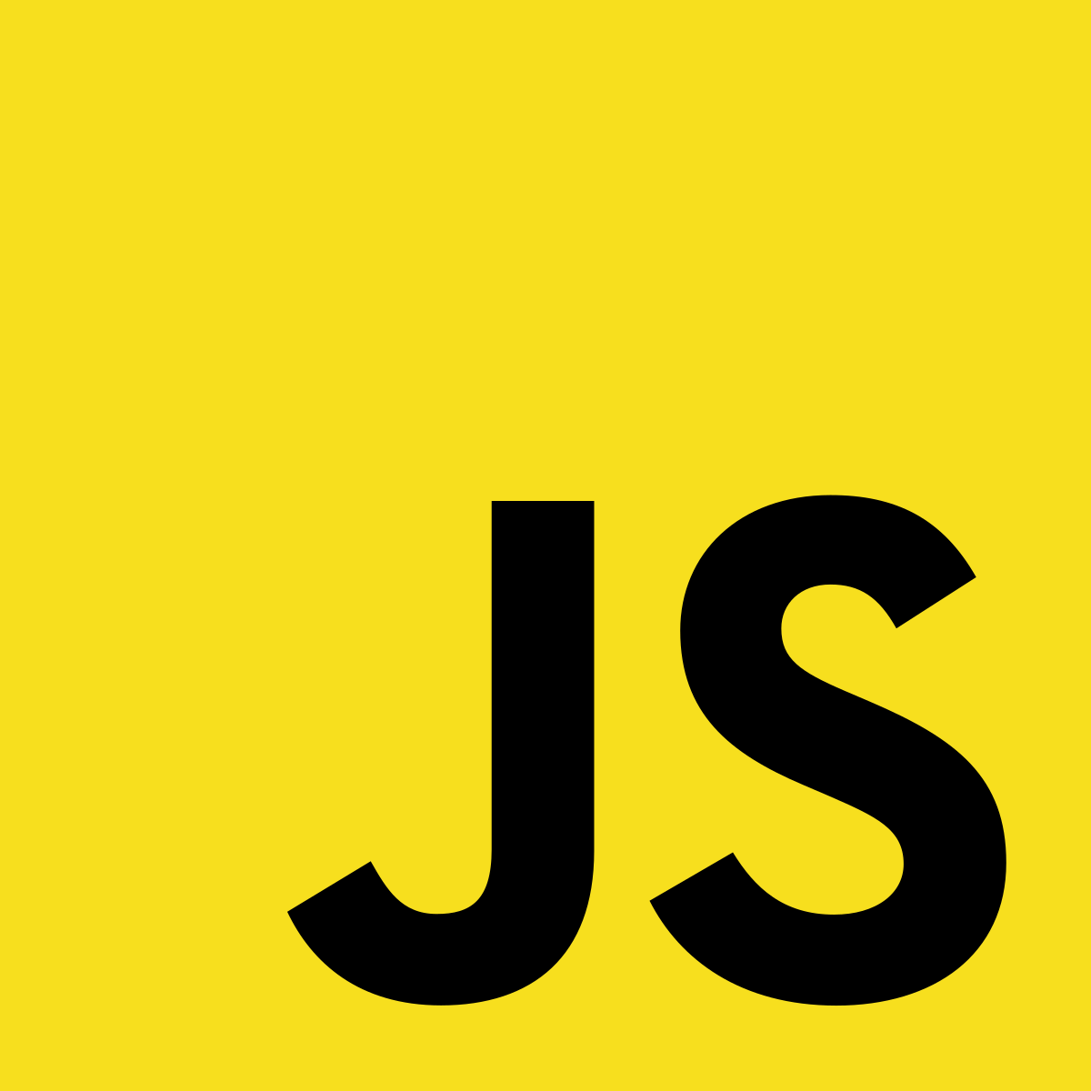
JavaScript

Slide 2
What is JavaScript
JavaScript is a scripting language that is used to create interactive and dynamic websites.
Interactive website means, user can perform some action on website for example: Button click, Submit a form, write comments and live chat.
Dynamic website means, the website that changes it’s content or layout like: Sliding effect, Ecommerce website and Quiz website.

Slide 3
Why you should learn JavaScript?
JavaScript is the most popular programming language in the world. It is used in almost all popular websites like: Google, Facebook, Twitter, Amazon, Netflix and many others.
Great thing about JavaScript is that you will find tons of frameworks and Libraries to reduce your time to create websites and mobile apps. Some of the popular frameworks are: React, Angular and Vue.js
If you learn JavaScript, it opens up a lot of job opportunities in the software development industry.

Slide 4
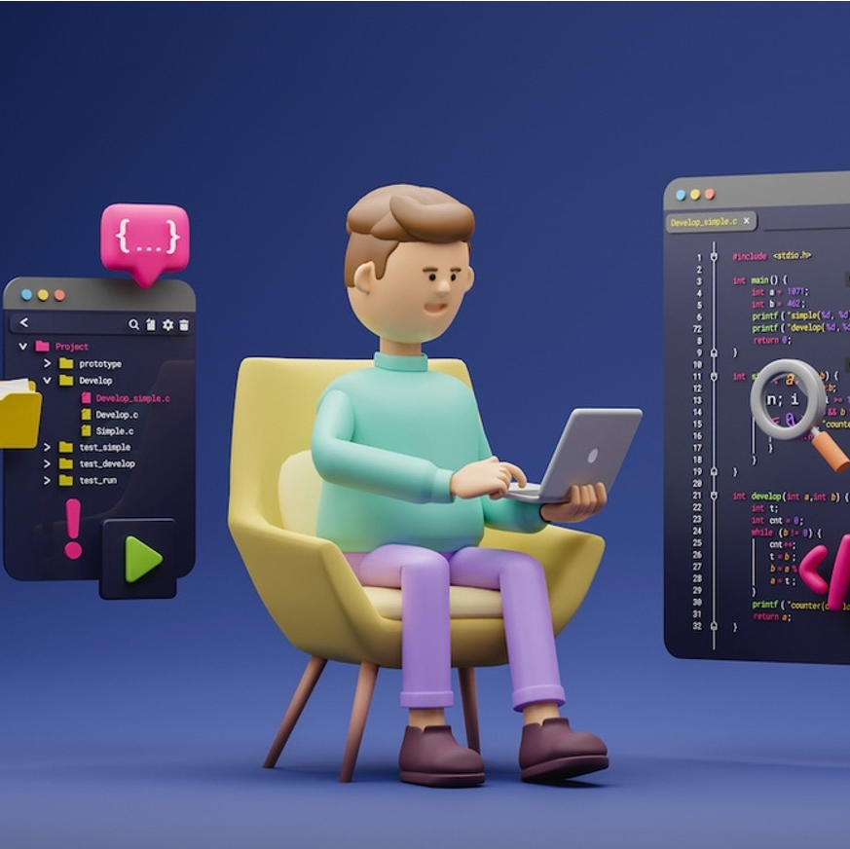
What is IDE
IDE stands for Integrated Development Environment.
Software suite that consolidates basic tools
required for software development.
Central hub for coding, finding
problems, and testing.
Designed to improve developer efficiency.

Slide 5
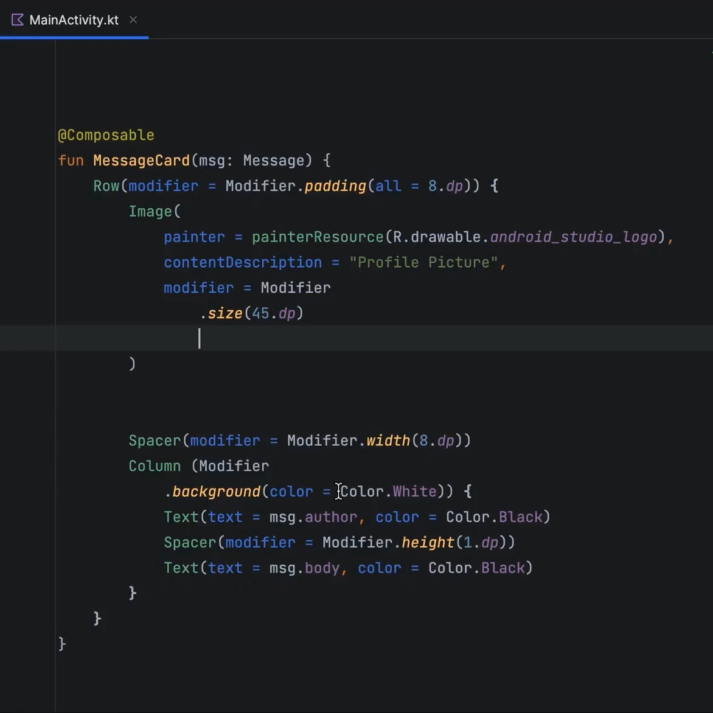
Need of IDE
Streamlines development.
Increases productivity.
Simplifies complex tasks.
Offers a unified workspace.
IDE Features
Code Autocomplete
Syntax Highlighting
Version Control
Error Checking

Slide 6
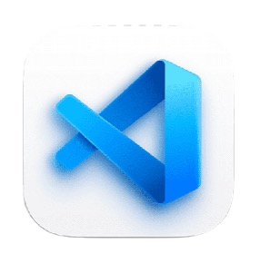
Installation & Setup
Search VS Code
Keep Your Software up to date

Slide 7
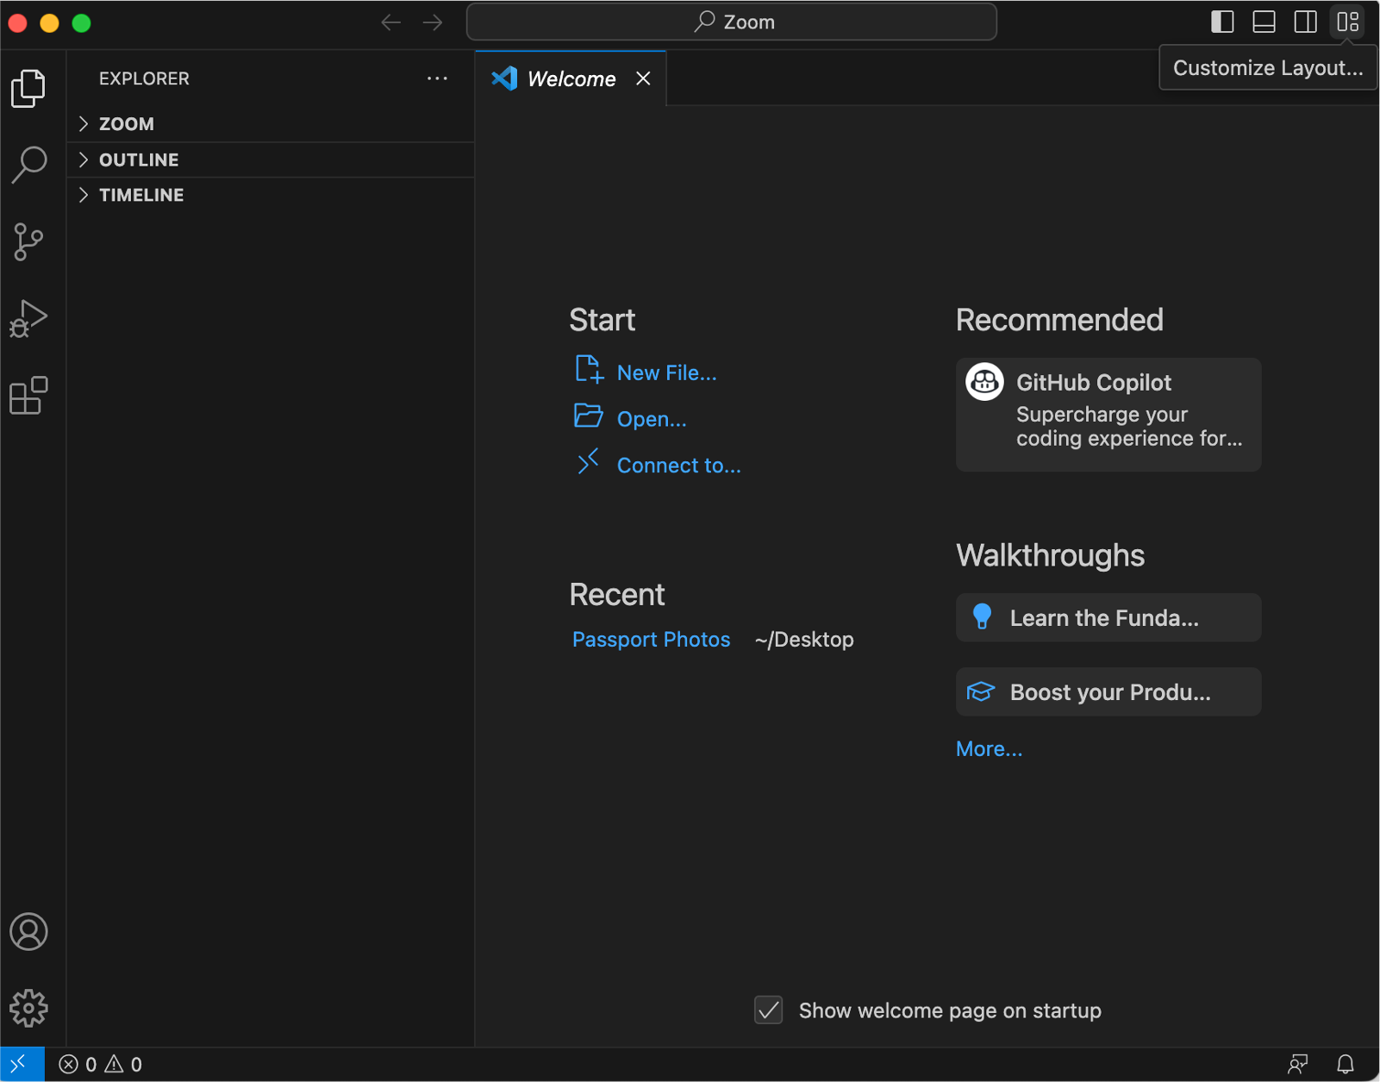
Opening project in VsCode

Slide 8


VsCode Extensions and Settings
Live Server
Prettier
Line Wrap
Tab Size from 4 to 2
Code Runner
Material Icon Theme

Slide 9
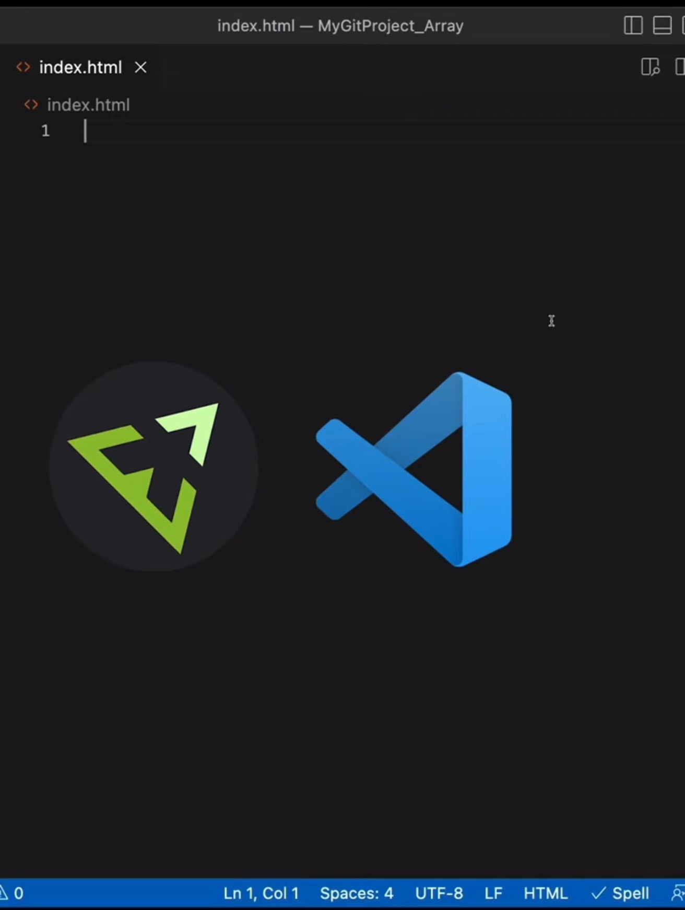
1. Type ! and wait for suggestions.
Using Emmet ! to generate code

Slide 10


HTML
(Hypertext Markup Language)
Structure: Sets up the layout.
Content: Adds text, images, links.
Tags: Uses elements like
<p>, <a>.
Hierarchy: Organizes elements in a tree.

Slide 11

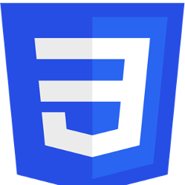
CSS
(Cascading Style Sheets)
Style: Sets the look and feel.
Colors & Fonts: Customizes text and background.
Layout: Controls position and size.
Selectors: Targets specific HTML elements.

Slide 12

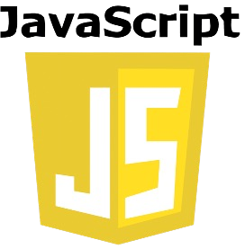
JS
(Java Script)
JavaScript has nothing to do with Java
Actions: Enables interactivity.
Updates: Alters page without reloading.
Events: Responds to user actions.
Data: Fetches and sends info to server.

Slide 13
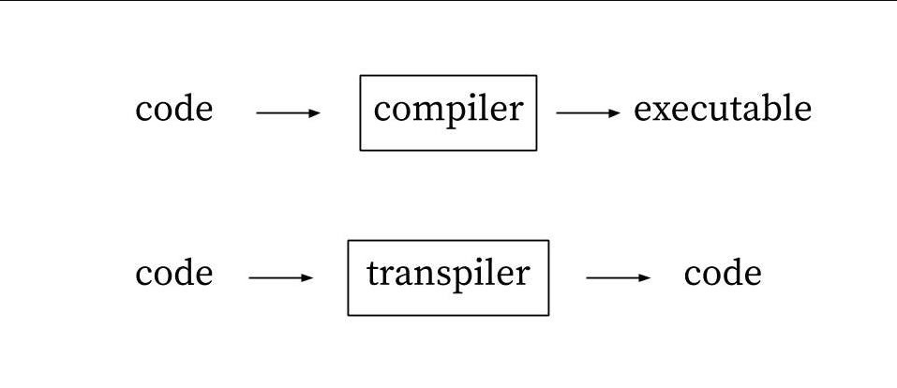
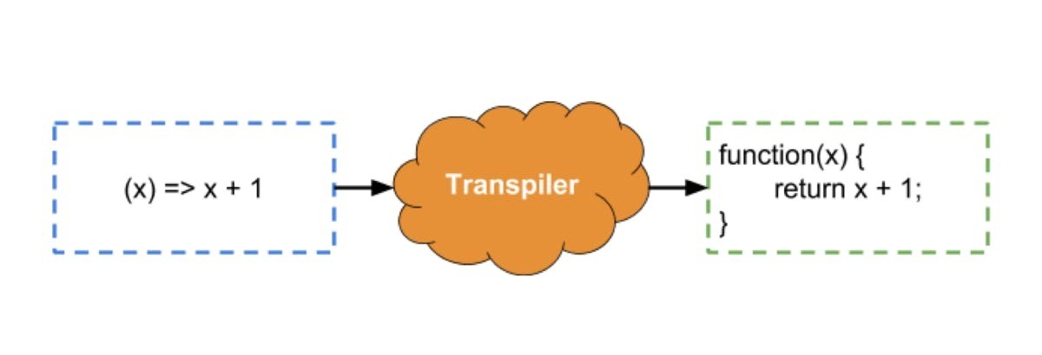
JS(JavaScript)
JavaScript runs at the client side in the browser.
Coffee Script / TypeScript are transpiled to JavaScript.

Slide 14
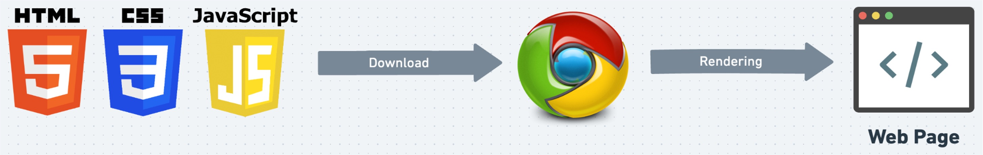
Role of Browser
Displays Web Page: Turns HTML code into what you see on screen.
User Clicks: Helps you interact with the web page.
Updates Content: Allows changes to the page using JavaScript.
Loads Files: Gets HTML, images, etc., from the server.

Slide 15
How to Run JS File
Install Node.js
Commands to run the JS file
JavaScript file must have extension .js
You can run the JS file directly from the extension
Or use the command node filename or node –watch filename

Slide 16
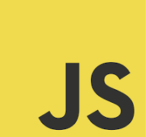
Day – 01 Overview, Placement of JavaScript, Variables, and Operators

Slide 17
Table of Contents
- Overview of JavaScript
- Placement of JavaScript
- Variables in JavaScript
- Constants in JavaScript
- JavaScript Data Types
- Operators in JavaScript
- Type Conversion
- Template Literals

Slide 18
Script Tag
Embed Code: Incorporates JavaScript into an HTML file, either directly or via external files.
Placement: Commonly placed in the <head> or just before the closing </body> tag to control when the script runs.
External Files: Use src attribute to link external JavaScript files, like <script src="script.js"></script>.

Slide 19
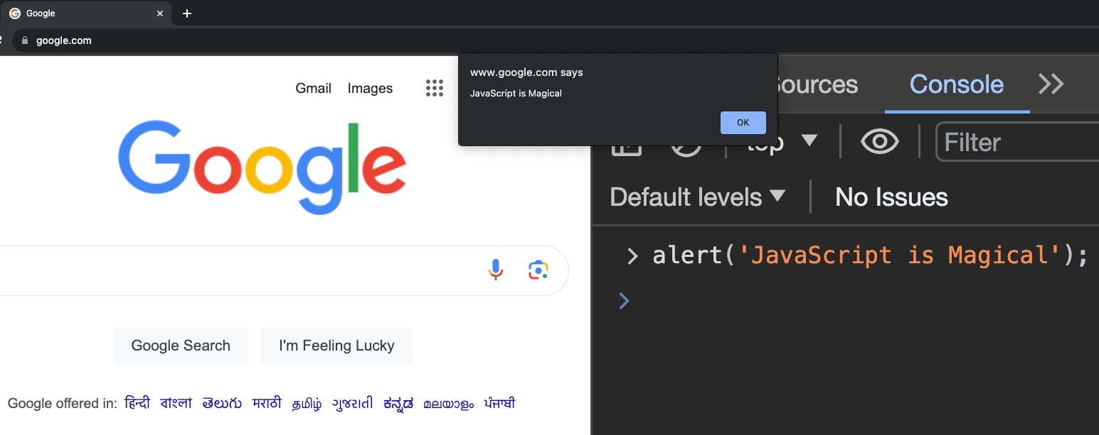
JS in Console (Alert)

Slide 20
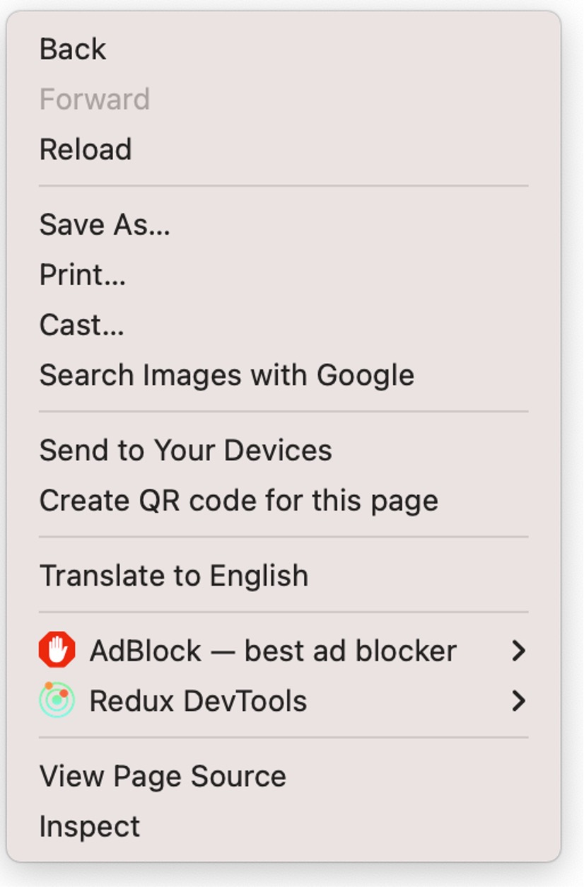
1. JS in Console (Inspect)
Allows real-time editing of HTML/CSS/JS
Run Scripts: Test code in console.
Debug: Locate and fix errors.
Modify DOM: Change webpage elements. Errors: View error messages.

Slide 21
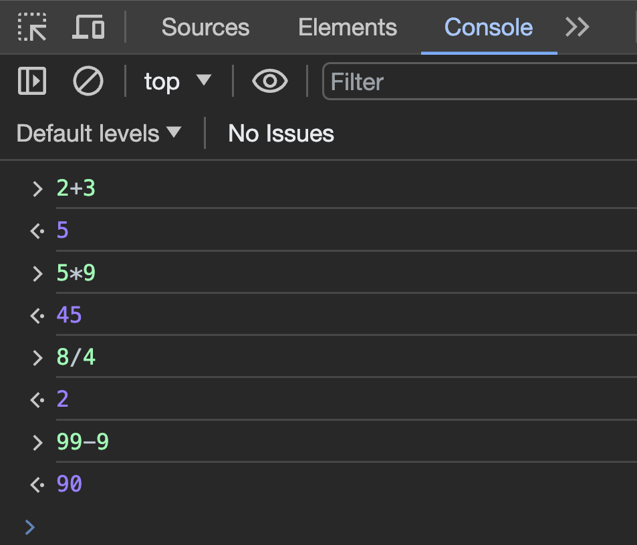
1. JS in Console (Math)
Console can be used as a Calculator

Slide 22
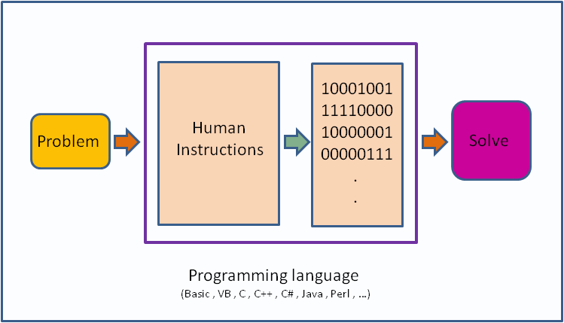
What is a Programming Language?
Giving instructions to a computer
Instructions: Tells computer what to do.
These instructions are called code.

Slide 23

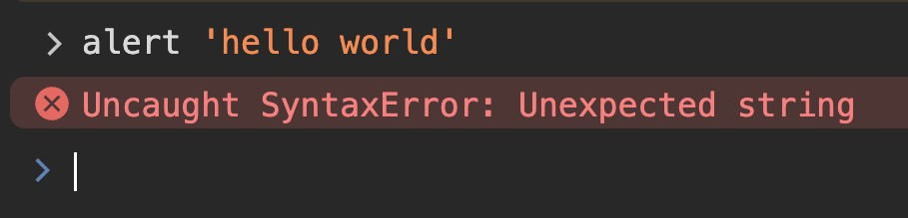
5. What is a Syntax?
Structure of words in a sentence.
Rules of the language.
For programming exact syntax must be followed.

Slide 24







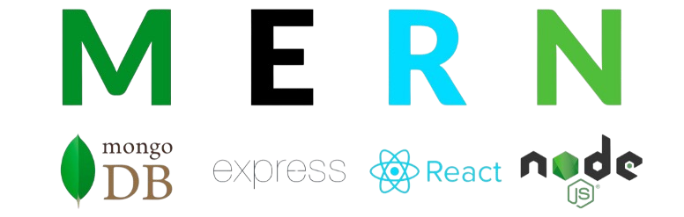
6. FrontEnd / BackEnd / FullStack
Client Side / Front-End Web Development
Server Side Back-End
Full Stack

Slide 25



Don’t learn syntax.
Google: Quick answers to coding problems.
MDN: In-depth guides and
documentation. https://developer.mozilla.org/
ChatGPT: Real-time assistance for coding queries. Don't prefer at your initial phase of carrier, first understand the basic concepts.
Focus: Understand concepts, not just syntax.

Slide 26
What is Variables in JavaScript?
Variables are used to store data. It is like a container, where we use to store things at home.
To declare a variable in JavaScript, we use the var, let, or const keyword.
The var keyword is the oldest and most common way to declare variables
The let keyword is a newer keyword that was introduced in ES6. (We will learn more about ES6 later in advance JavaScript)
The const keyword is used to declare constants, which are variables that cannot be changed. Once you have declared a variable, you can assign a value to it using the equal sign (=).
For example:
var x = 30;
Let a = 25;
const assignName = "Js Session Day 1";

Slide 27
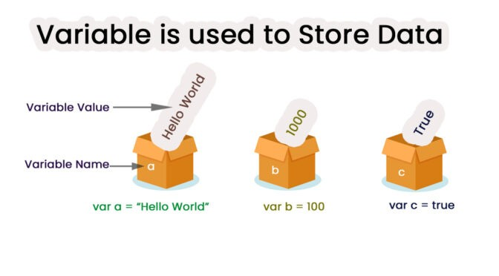
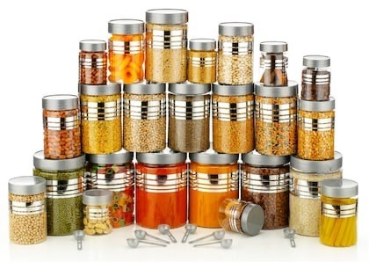
What are Variables?
Variables are like containers used for storing data values.

Slide 28
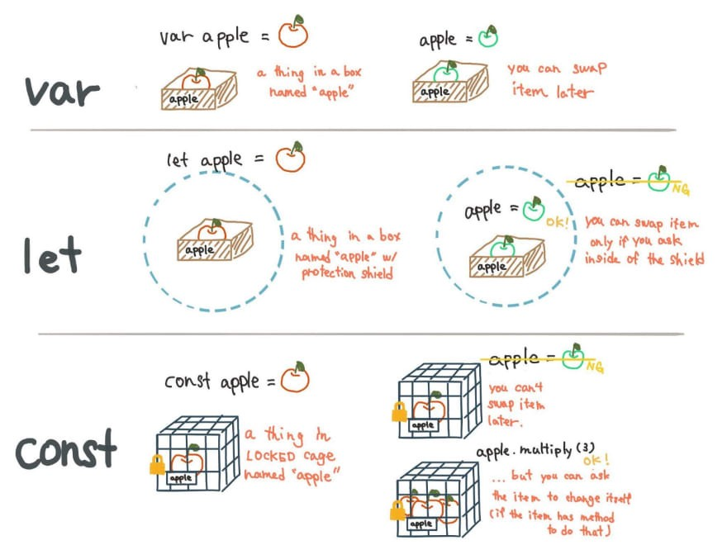
Ways to Create Variables

Slide 29
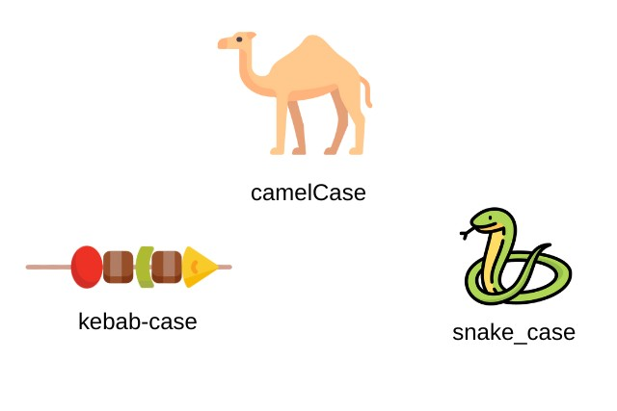
Naming Conventions
camelCase
Start with a lowercase letter. Capitalize the first letter of each subsequent word.
Example: myVariableName
snake_case
Start with an lowercase letter. Separate words with underscore
Example: my_variable_name
Kebab-case
All lowercase letters. Separate words with hyphens. Used for HTML and CSS.
Example: my-variable-name
Pascal Case
names in pascal case start with a capital letter
Example : FirstName, LastName
Keep a Good and Short Name
Choose names that are descriptive but not too long. It should make it easy to understand the variable's purpose.
Example: age, firstName, isMarried

Slide 30
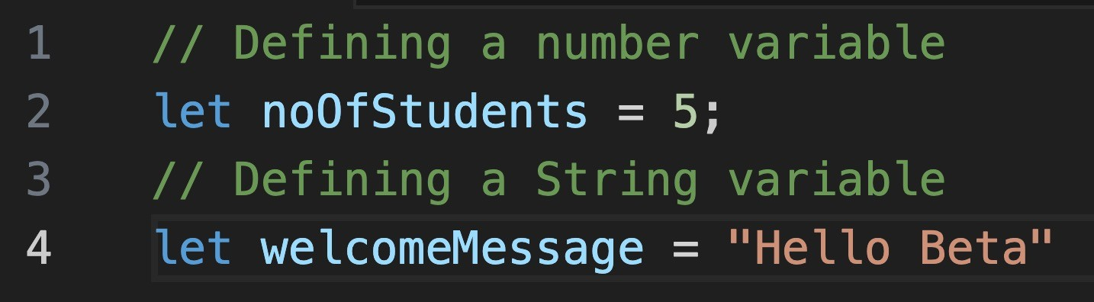
Syntax Rules
A JavaScript name must begin with:
A letter (A-Z or a-z) A dollar sign ($)
Or an underscore (_)
Subsequent characters may be letters, digits, underscores, or dollar signs. Numbers are not allowed as the first character in names.
JavaScript is case sensitive.
firstName and firstname are different.

Slide 31
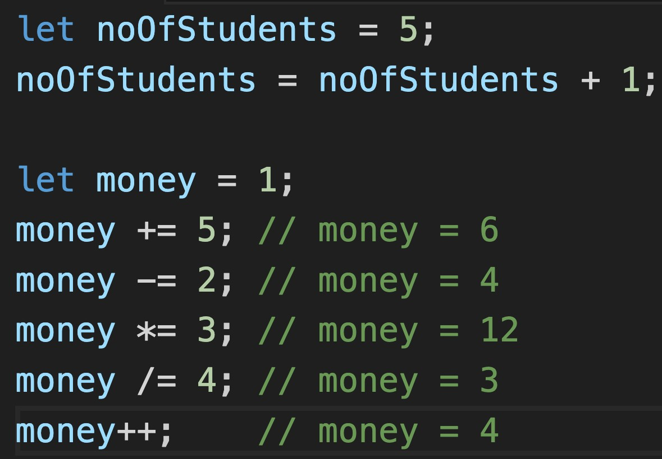
21. Updating Values
Do not need to use let again.
Syntax: variable = variable + 1
Assignment Operator is used =
Short Hand Assignment Operators:
+=, -=, *=, /=, ++

Slide 32
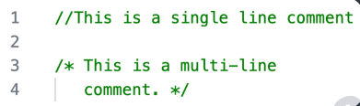
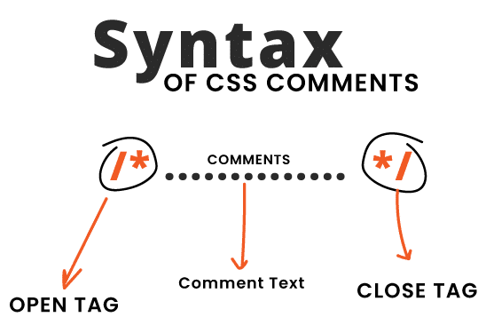
JavaScript & CSS Comments
Used to add notes in source code in JavaScript or CSS.
Not displayed on the web page
Syntax: /* comment here */
Helpful for code organization
Can be multi-line or single-line

Slide 33
Data Types in JavaScript
Data types is an important concept in any programming language. To perform any task with the Data, it is import to know it’s type.
Data types in JavaScript are divided into 2 categories:
Primitive data type and reference data type.
There are 7 primitive data types in JavaScript, Which are: string, number, boolean, null, undefined, bigint and symbol

Slide 34
String
In JavaScript, a string is a sequence of zero or more characters. A string starts and ends with either a single quote(') or a double quote (").
JavaScript strings are for storing and manipulating text. Example:

Slide 35
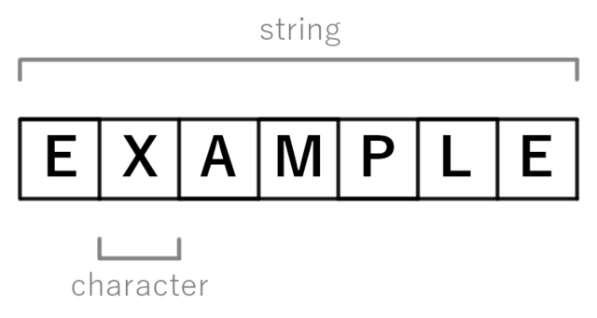
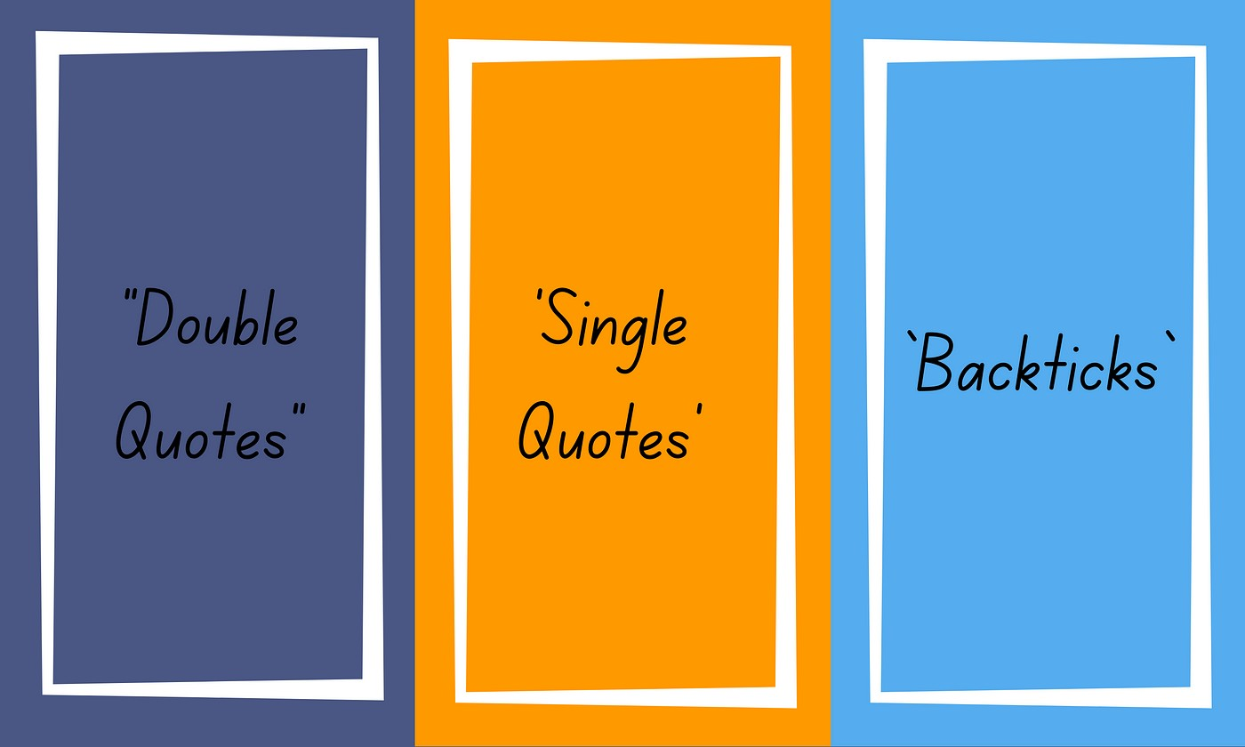
Strings
Strings hold textual data, anything from a single character to paragraph.
Strings can be defined using single
quotes ' ', double quotes " ", or backticks ` `. Backticks allow for template literals, which can include variables.
You can combine (concatenate)
strings using the + operator. For example, "Hello" + " World" will produce "Hello World".

Slide 36
Number
Number represents integer and floating-point numbers. Example:
let num = 100;
The following statement declares a variable and initializes its value with an integer
let marks = 96.5;
Here we have stored the floating-point number. If we write
let marks = 96.00;
JavaScript will convert it into an integer number to use less memory. It will be saved as 96
console.log(marks); // 96
To check the type of the data stored in a variable , we use typeof operator

Slide 37
Boolean
The boolean type has two values: true and false. Example:
let x = 20>10;
Result of this comparison is true, so the data type will be boolean.

Slide 38
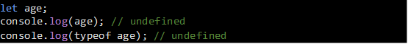
Undefined
If a variable is declared but the value is not assigned, then the value of that variable will be undefined. And the data type is also undefined.
Now understand it with example:
we have declared a variable age but not assigned any value.

Slide 39
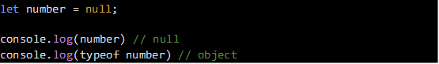
null
In the JavaScript, null is a special value that represents empty or unknown value Example:
The type should be "null" but it says the type is object. It is a known bug in JavaScript.
JavaScript defines that null is equal to undefined
To check this, let me write:
console.log(null == undefined); // true

Slide 40
Reference Data-Type:
Object
Array
function

Slide 41
Objects
What is an Object
Objects Syntax
Accessing Objects
Inside Objects
Autoboxing
Object References
Object Shortcuts

Slide 42
Types of Objects
JavaScript objects
Objects that are part of JavaScript
Examples: window, document
Browser objects
Objects that contain info not about the contents of the display, but the browser itself
Examples: history, navigator
User-defined object

Slide 43
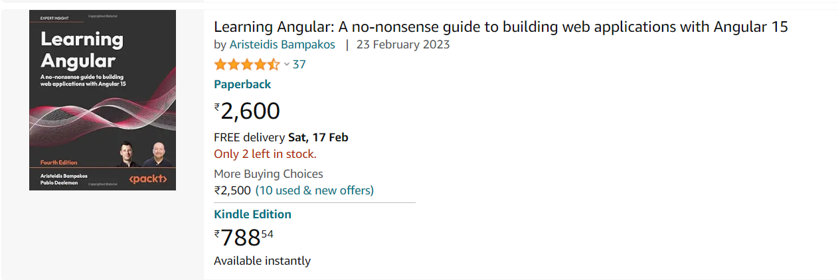
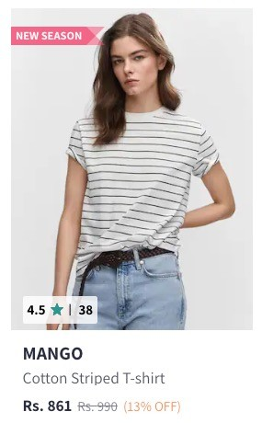
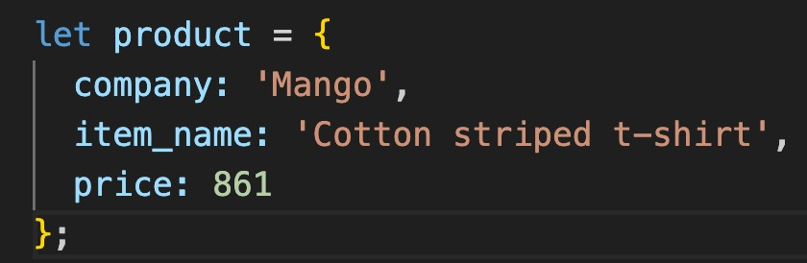
36. What is an Object?
Groups multiple values together in key-value pairs.
How to Define: Use {} to enclose properties.
Example: product {name, price}
Dot Notation: Use . operator to access values.
Key Benefit: Organizes related data under a single name.

Slide 44
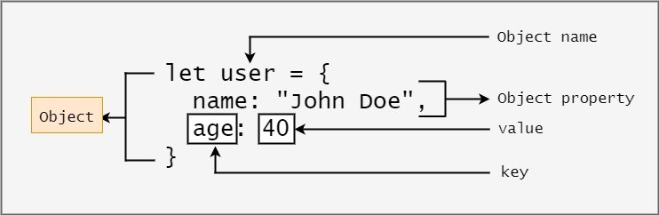
37. Object Syntax?
Basic Structure: Uses {} to enclose data.
Rules: Property and value separated by a colon(:)
Comma: Separates different property-value pairs.
Example: { name: "Laptop", price: 1000 }

Slide 45


38. Accessing Objects
Dot Notation: Access properties using . Operator like product.price
Bracket Notation: Useful for properties with special characters product[”nick-name"]. Variables can be
used to access properties
typeof returns object.
Values can be added or removed to an object
Delete Values using delete

Slide 46

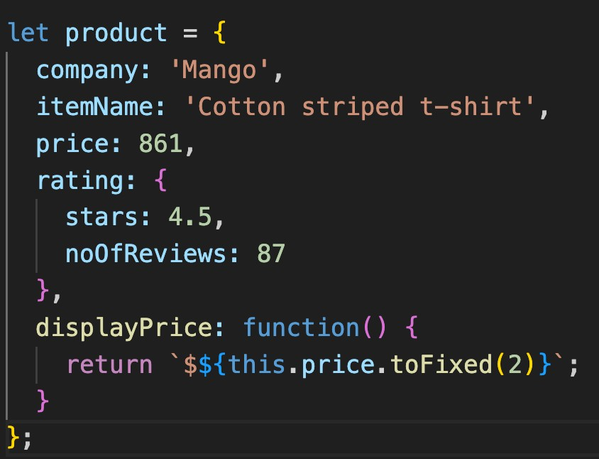
39. Inside Object
Objects can contain Primitives like numbers and strings.
Objects can contain other objects and are called Nested Objects.
Functions can be object properties.
Functions inside an object are called methods.
Null Value: Intentionally leaving a property empty.

Slide 47
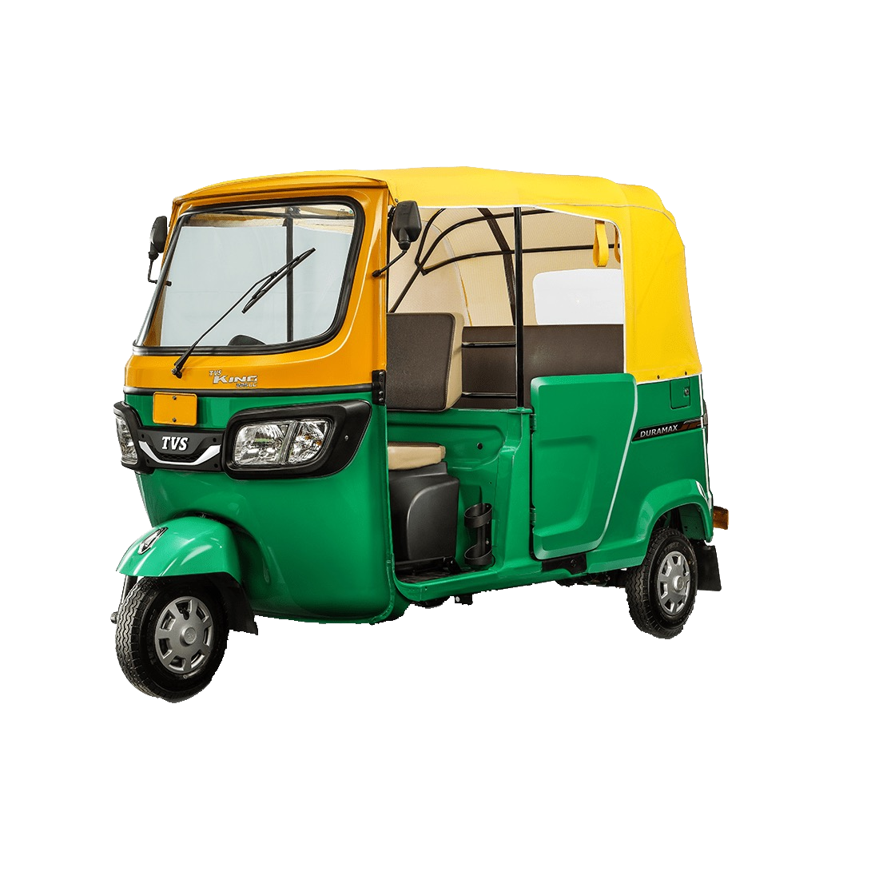

40. Autoboxing
Automatic conversion of primitives to objects.
Allows properties and methods to be used on primitives.
Example: Strings have properties and methods like length, toUpperCase, etc.

Slide 48
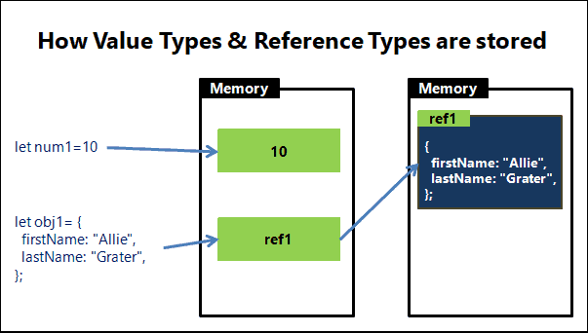
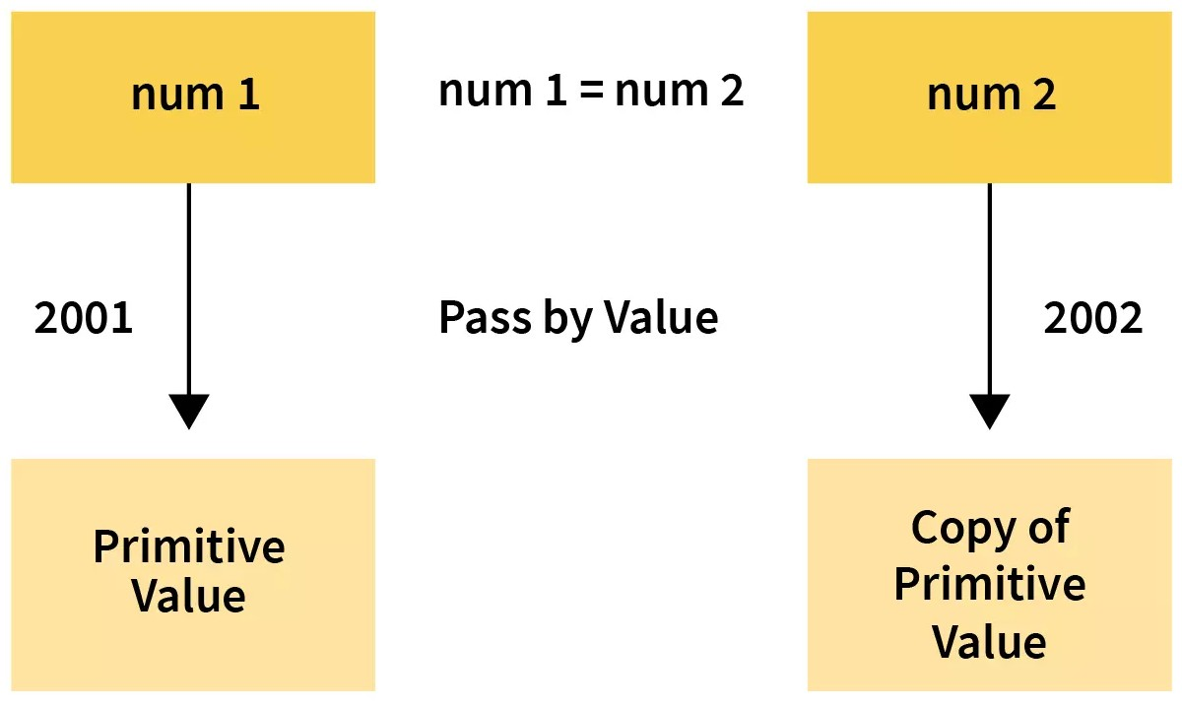
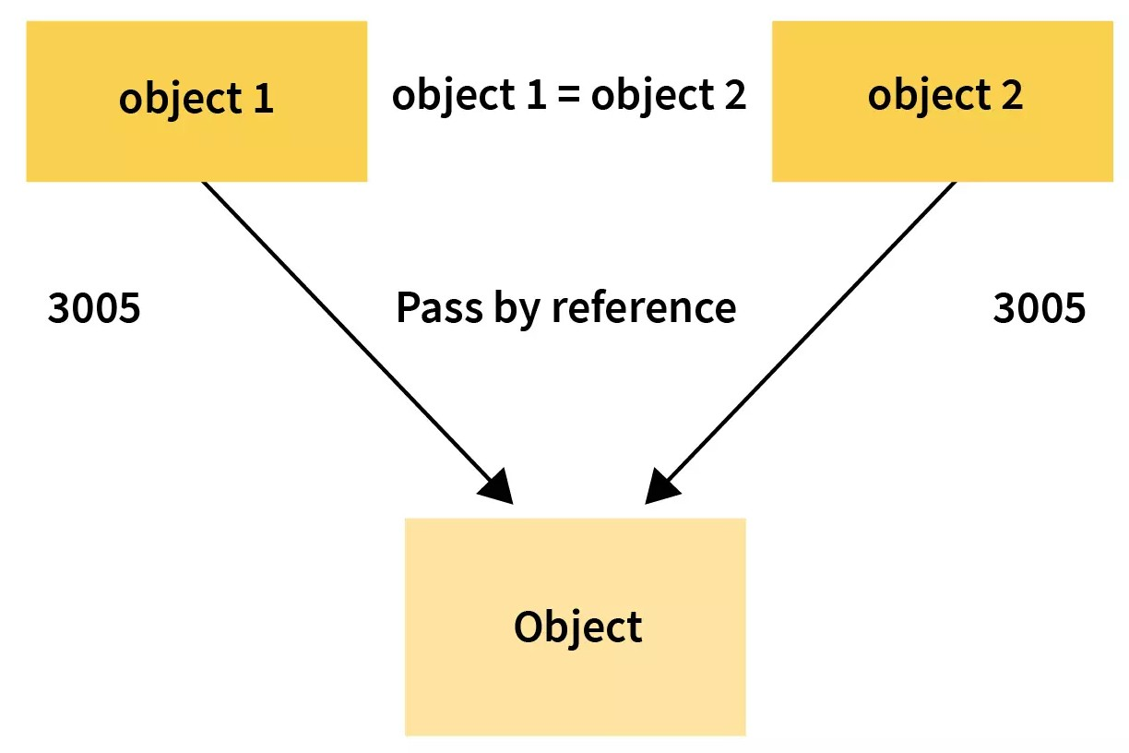
41. Object References
Objects work based on references, not actual data.
Copying an object copies the reference, not the actual object.
When comparing with ==, you're comparing
references, not content.
Changes to one reference affects all copies.

Slide 49
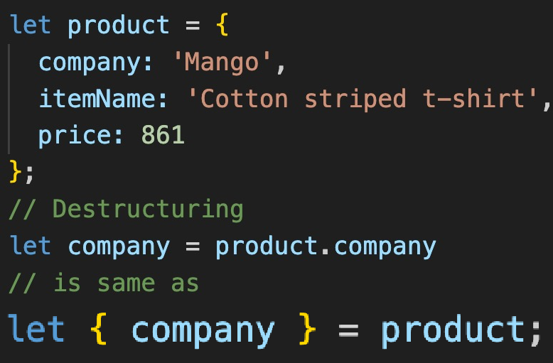
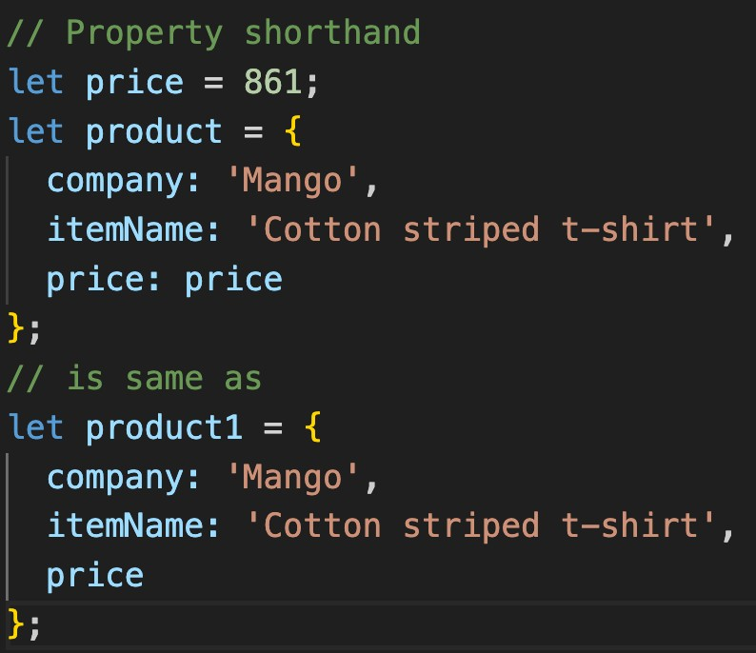
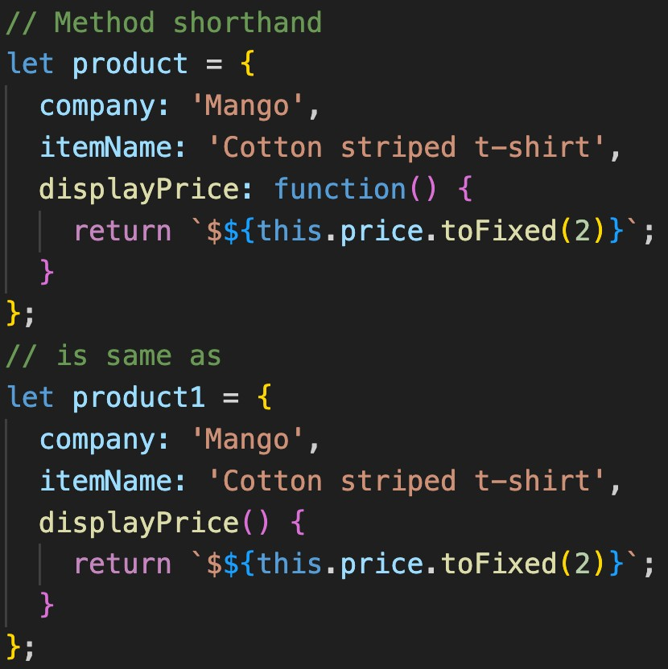
42. Object Shortcuts
De-structuring: Extract properties from objects
easily.
We can extract more than one property at once.
Shorthand Property: {message: message}
simplifies to just message.
Shorthand Method: Define methods directly inside
the object without the function keyword.

Slide 50

Revision
Objects
What is an Object
Objects Syntax
Accessing Objects
Inside Objects
Autoboxing
Object References
Object Shortcuts

Slide 51

Practice Exercise
Objects
Create object to represent a product from Myntra
Create an Object with two references and log changes to one object by changing the other one.
Use bracket notation to display delivery-time.
Given an object {message: 'good job', status: 'complete'},
use de-structuring to create two variables message and status.
Add function isIdenticalProduct to compare two product objects.

Slide 52
Arrays
What is an Array?
Array Syntax & Values
Array Properties & Methods

Slide 53
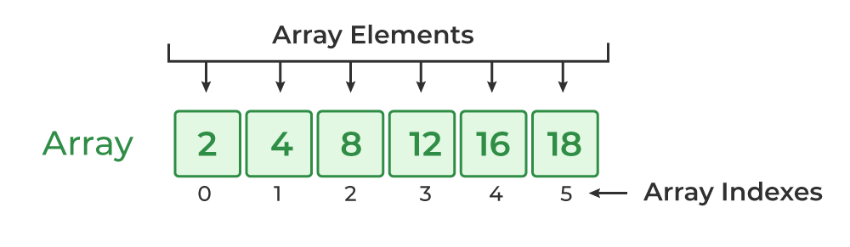
47. What is an Array?
An Array is just a list of values.
Index: Starts with 0.
Arrays are used for storing multiple values in a single variable.

Slide 54
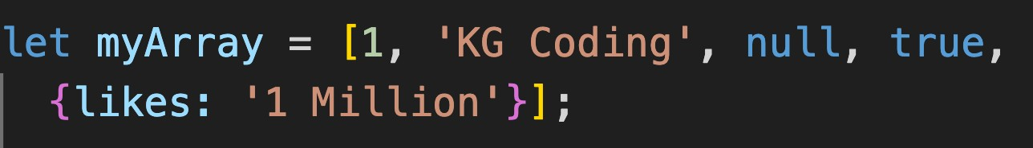
48. Array Syntax & Values
Use [] to create a new array, [] brackets enclose list of values
Arrays can be saved to a variable.
Accessing Values: Use [] with index.
Syntax Rules:
Brackets start and end the array.
Values separated by commas.
Can span multiple lines.
Arrays can hold any value, including arrays.
typeof operator on Array Returns Object.

Slide 55
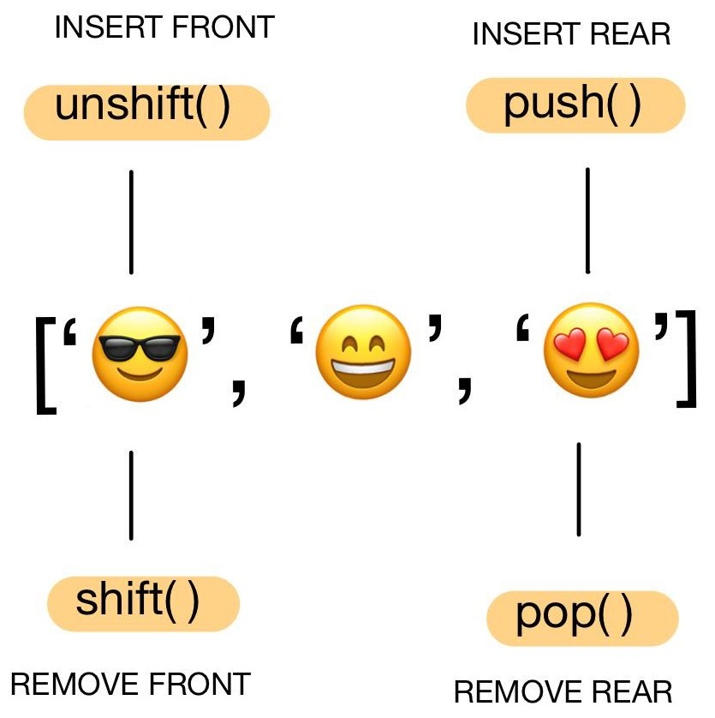
49. Array Properties & Methods
Array.isArray() checks if a variable is an array.
Length property holds the size of the array.
Common Methods:
push/pop: Add or remove to end.
shift/unshift: Add or remove from front.
splice: Add or remove elements.
toString: Convert to string.
sort: Sort elements.
valueOf: Get array itself.
Arrays also use reference like objects.
De-structuring also works for Arrays.

Slide 56
Functions
What are Functions
Function Syntax
Return statement
Function Parameters

Slide 57
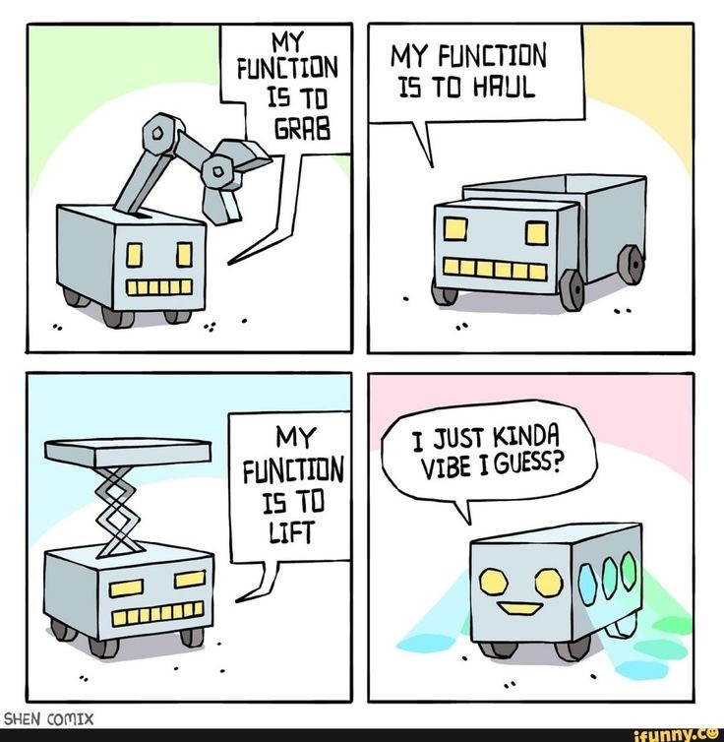
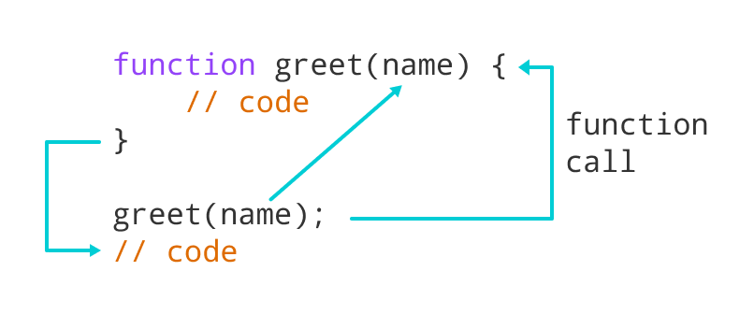
32. What are Functions?
Definition: Blocks of reusable code.
DRY Principle: "Don't Repeat Yourself" it Encourages code reusability.
Usage: Organizes code and performs specific tasks.
Naming Rules: Same as variable names: camelCase
Example: ”Beta Gas band kar de"

Slide 58
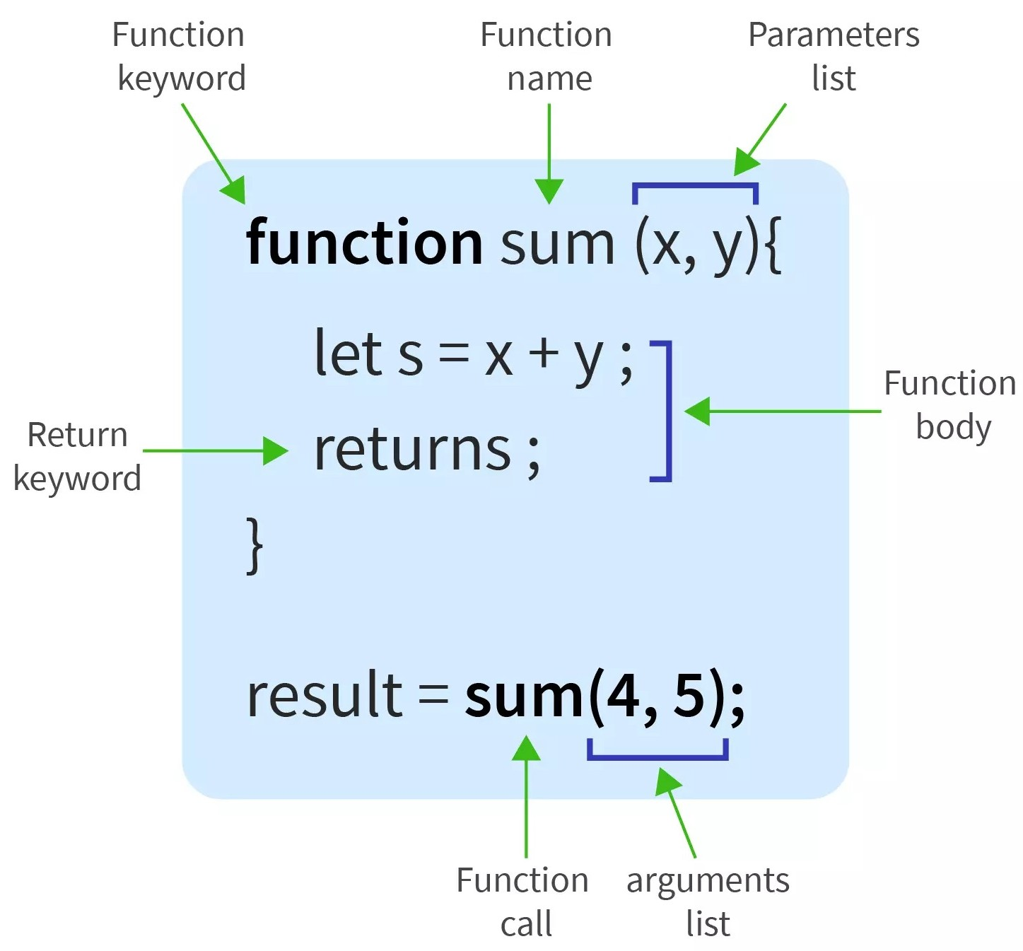
33. Functions Syntax
Use function keyword to declare.
Follows same rules as variable names.
Use () to contain parameters.
Invoke by using the function name followed by ().
Fundamental for code organization and reusability.

Slide 59
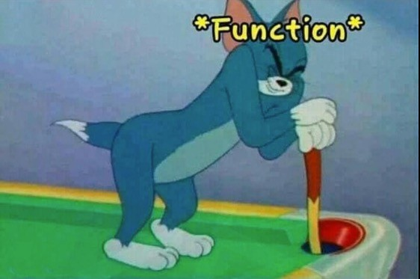
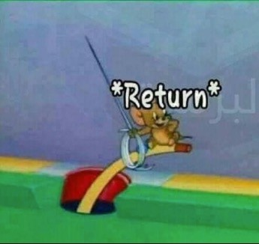
34. Return statement
Sends a value back from a function.
Example: "Ek glass paani laao"
What Can Be Returned: Value, variable, calculation, etc.
Return ends the function immediately.
Function calls make code jump around.
Prefer returning values over using global variables.

Slide 60




35. Parameters
Parameter
Function
Return
Input values that a function takes.
Parameters put value into function, while return gets value out.
Example: "Cheescake”
Naming Convention: Same as variable names.
Parameter vs Argument
Examples: alert, Math.round, console.log are functions we have already used
Multiple Parameters: Functions can take more than one.
Default Value: Can set a default value for a parameter.

Slide 61
Revision
Functions
What are Functions
Function Syntax
Return statement
Function Parameters

Slide 62
Practice Exercise
Functions
Create a method to check if a number is odd or even.
Create a method to return larger of the two numbers.
Create Method to convert Celsius to
Fahrenheit
F = (9/5) * C + 32

Slide 63

12. Type Of Operator
Check Type: Tells you the data type of a variable.
Syntax: Use it like typeof variable.
Common Types: Returns "number," "string," "boolean," etc.

Slide 64

Arithmetic Operators

Slide 65


8. Order of Operations

Slide 66



if-else & Boolean
25.What are Booleans 26.Comparison Operators 27.if-else
Logical Operator
Scope
Truthy and Falsy Values
If alternates
Create Project

Slide 67


25. What are Booleans?
Data Type: Booleans are a basic data type in JavaScript.
Two Values: Can only be true or false.
‘true’ is a String not a Boolean

Slide 68

26. Comparison Operators
Equality
== Checks value equality.
=== Checks value and type equality.
Inequality
!= Checks value inequality.
!== Checks value and type inequality.
Relational
> Greater than.
< Less than.
>= Greater than or equal to.
<= Less than or equal to.
Order of comparison operators is less than arithmetic operators

Slide 69

27. if-else
Syntax: Uses if () {} to check a condition.
What is if: Executes block if condition is true, skips if false.
What is else: Executes a block when the if condition is false.
Curly Braces can be omitted for single statements, but not recommended.
If-else Ladder: Multiple if and else if blocks; only one
executes.
Use Variables: Can store conditions in variables for use in if statements.

Slide 70








28. Logical Operators
1. Types: && (AND), || (OR), ! (NOT)
AND (&&): All conditions must be true for the result to be true.
OR (||): Only one condition must be true for the result to be true.
NOT (!): Inverts the Boolean value of a condition.
Lower Priority than Math and Comparison operators

Slide 71

30. Truthy and Falsy Values
Falsy Values: 0, null, undefined, false, NaN, "" (empty string)
Truthy Values: All values not listed as falsy.
Used in conditional statements like if.
Non-boolean values are auto-converted in logical operations.
Be explicit in comparisons to avoid unexpected behaviour.

Slide 72
31. If alternates
Ternary Operator: condition ? trueValue : falseValue
Quick one-line if-else.
Guard Operator: value || defaultValue
Use when a fallback value is needed.
Default Operator: value ?? fallbackValue
Use when you want to consider only null and undefined as falsy.
Simplifies conditional logic.
Use wisely to maintain readability.

Slide 73
Revision
if-else & Boolean
25.What are Booleans 26.Comparison Operators 27.if-else
Logical Operator
Scope
Truthy and Falsy Values
If alternates

Slide 74
Practice Exercise
if-else & Boolean
Give discount based on age, gender for metro ticket
Females get 50% off
Kids under 5 years of age are free
Kids up to 8 years have half ticket
People Over 65 years of age only pay 30% of the ticket
In case of multiple discounts max discount will apply.

Slide 75

29. Scope
Any variable created inside {} will remain inside {}
Variable can be redefined inside {}
Var does not follow scope
Global Scope: Accessible everywhere in the code.
Block Scope: Limited to a block, mainly with let and const.
Declare variables in the narrowest scope possible.

Slide 76
JSON, Local Storage, Date & DOM
What is JSON?
Local Storage
Date
DOM Properties & Methods
Finish
Project

Slide 77

43. What is JSON?
JavaScript Object Notation: Not the same as JS object, but similar.
Common in network calls and data storage.
JSON.stringify() and JSON.parse()
Strings are easy to transport over network.
JSON requires double quotes. Escaped as \".
JSON is data format, JS object is a data structure.

Slide 78


44. Local Storage
Persistent data storage in the browser.
setItem: Stores data as key-value pairs.
Only strings can be stored.
getItem: Retrieves data based on key.
Other Methods: localStorage.clear(), removeItem().
Do not store sensitive information. Viewable in storage console.

Slide 79

45. Date
new Date() Creates a new Date object with the current date and time.
Key Methods:
getTime(): Milliseconds since Epoch.
getFullYear(): 4-digit year
getDay(): Day of the week
getMinutes(): Current minute
getHours(): Current hour.
Crucial for timestamps, scheduling, etc.

Slide 80
46. DOM Properties & Methods
DOM and Element Properties
location
title
href
domain
innerHTML
innerText
classList
DOM and Element Methods
getElementById()
querySelector()
classList: add(), remove()
createElement()
appendChild()
removeChild()
replaceChild()

Slide 81
JSON, Local Storage, Date & DOM
Revision
What is JSON?
Local Storage
Date
DOM Properties & Methods

Slide 82
Practice Exercise
JSON ,Local Storage, Date & DOM
Display good morning, afternoon and night based on current hour.
Add the name to the output too.
Create a Button which shows the number how many times
it has been pressed.
Also, it has different colors for when it has been pressed odd or even times.
The click count should also survive browser refresh.

Slide 83
Arrays & Loops
What is an Array?
Array Syntax & Values
Array Properties & Methods
What is a Loop?
While Loop
Do While Loop
For Loop
Accumulator Pattern
Break & Continue

Slide 84
47. What is an Array?
An Array is just a list of values.
Index: Starts with 0.
Arrays are used for storing multiple values in a single variable.

Slide 85
48. Array Syntax & Values
Use [] to create a new array, [] brackets enclose list of values
Arrays can be saved to a variable.
Accessing Values: Use [] with index.
Syntax Rules:
Brackets start and end the array.
Values separated by commas.
Can span multiple lines.
Arrays can hold any value, including arrays.
typeof operator on Array Returns Object.

Slide 86
49. Array Properties & Methods
Array.isArray() checks if a variable is an array.
Length property holds the size of the array.
Common Methods:
push/pop: Add or remove to end.
shift/unshift: Add or remove from front.
splice: Add or remove elements.
toString: Convert to string.
sort: Sort elements.
valueOf: Get array itself.
Arrays also use reference like objects.
De-structuring also works for Arrays.

Slide 87

50. What is a Loop?
Code that runs multiple times based on a condition.
Loops also alter the flow of execution, similar to functions.
Functions: Reusable blocks of code.
Loops: Repeated execution of code.
Loops automate repetitive tasks.
Types of Loops: for, while, do-while.
Iterations: Number of times the loop runs.

Slide 88


51. While Loop
Iterations: Number of times the loop runs.
Used for non-standard conditions.
Repeating a block of code while a condition is true.
Remember: Always include an update to avoid infinite loops.

Slide 89


52.Do While Loop
Executes block first, then checks condition.
Guaranteed to run at least one iteration.
Unlike while, first iteration is unconditional.
Don't forget to update condition to avoid infinite loops.

Slide 90


53.For Loop
Standard loop for running code multiple times.
Generally preferred for counting iterations.

Slide 91

54.Accumulator Pattern
A pattern to accumulate values through looping.
Common Scenarios:
Sum all the numbers in an array.
Create a modified copy of an array.

Slide 92


55.Break & Continue
Break lets you stop a loop early, or break out of a loop
Continue is used to skip one iteration or the current iteration
In while loop remember to do the increment manually
before using continue

Slide 93
Revision
Arrays & Loops
What is an Array?
Array Syntax & Values
Array Properties & Methods
What is a Loop?
While Loop
Do While Loop
For Loop
Accumulator Pattern
Break & Continue

Slide 94
Practice Exercise
Arrays & Loops
Create an array of numbers [5,6]. Add 4 at the beginning and 7 at the end of the array.
Create a method to return an element at a particular position in the array.
Create an array copy using slice method.
Create a while loop that exits after counting 5 prime numbers.
Modify the above loop to finish using break.
Create a for loop that prints number 1 to 10 in reverse order.
Using continue only print positive numbers from the given array [1,-6,5,7,-98]
Using accumulator pattern concatenate all the strings in the
given array [‘KG’, ‘Coding’, ‘Javascript’, ‘Course’, ‘is’, ‘Best’]

Slide 95
Advance Functions
Anonymous Functions As Values
Arrow functions
setTimeout & setInterval
Event Listener
For Each Loop
Array methods

Slide 96

56. Anonymous Functions As Values
Functions in JavaScript are first-class citizens; they can be assigned to variables.
Functions defined without a name, often assigned to a variable.
Anonymous functions can be properties in objects
Can be passed as arguments to other functions.
Invoked using () after the function name or variable.
console.log(myFunction); and typeof myFunction will both indicate it's a function.

Slide 97

57. Arrow Functions
A concise way to write anonymous functions.
For Single Argument: Round brackets optional.
For Single Line: Curly brackets and return optional.
Often used when passing functions as arguments.

Slide 98


58. setTimeout & setInterval
Functions for executing code asynchronously after a delay.
setTimeout runs once; setInterval runs repeatedly
setTimeout:
Syntax: setTimeout(function, time)
Cancel: clearTimeout(timerID)
setInterval:
Syntax: setInterval(function, time)
Cancel: clearInterval(intervalID)

Slide 99

59. Event Listener
What Is an Event: Occurrences like clicks, mouse movement, keyboard input (e.g., birthday, functions).
Using querySelector to attach listeners.
Multiple Listeners: You can add more than one.
removeEventListener('event', functionVariable);

Slide 100

60. For Each Loop
A method for array iteration, often preferred for readability.
Parameters: One for item, optional second for index.
Using return is similar to continue in traditional loops.
Not straightforward to break out of a forEach loop.
When you need to perform an action on each array element and don't need to break early.

Slide 101

61. Array Methods
Filter Method:
Syntax: array.filter((value, index) => return true/false)
Use: Filters elements based on condition.
Map Method:
Syntax: array.map((value) => return newValue)
Use: Transforms each element.

Slide 102
Revision
Advance Functions
Anonymous Functions As Values
Arrow functions
setTimeout & setInterval
Event Listener
For Each Loop
Array methods

Slide 103
Practice Exercise
Advance Functions
Create a variable multiply and assign a function to this variable that multiplies two numbers. Call this method from
the variable.
Create a function runTwice that takes a function as a parameter and then runs that method twice.
Create a button which should grow double in size on clicking after 2 seconds.
In the above exercise add the behavior using an event listener instead of onclick.
Create a function that sums an array of numbers. Do this using a for-each loop.
Create a function that takes an array of numbers and
return their squares using map function.

Slide 104

2. DOM Manipulation
Change HTML
Change CSS
Perform Actions

Slide 105
14 Basic HTML Page
<!DOCTYPE html> Defines the HTML Version
<html lang="en"> Parent of all HTML tags / Root element
<head> Parent of meta data tags
<title>My First Webpage</title> Title of the web page
</head>
<body> Parent of content tags
<h1>Hello World!</h1> Heading tag
</body>
</html>

Slide 106

14 HTML DOM
Structure Understanding: Helps in understanding the hierarchical structure of a webpage, crucial for applying targeted CSS styles.
Dynamic Styling: Enables learning about dynamic styling, allowing for real-time changes and interactivity through CSS.

Slide 107

14 HTML (Attributes)
Provides additional information about elements
Placed within opening tags
Common examples: href, src, alt
Use name=value format
Can be single or multiple per element

Slide 108

15 CSS (Basic Syntax)
Selector: The HTML element that you want to style.
Property: The attribute you want to change (like font, color,
etc.).
Value: The specific style you want to apply to the property (like red, bold, etc.).

Slide 109


15 CSS (Element selector)
Targets Elements: Selects HTML elements based on their tag name.
Syntax: Simply use the element's name
Uniform Styling: Helps in applying consistent styles to all instances.
Ease of Use: Straightforward and easy to implement for basic styling.

Slide 110


15 CSS (id & class attribute)
ID Property: Assigns a unique identifier to a single HTML element.
Class Property: Allows grouping of multiple HTML elements to style them collectively.
Reusable Classes: Class properties can be reused across different elements for consistent styling.
Specificity and Targeting: Both properties assist in targeting
specific elements or groups of elements for precise styling.

Slide 111


15 CSS (Id selector)
Unique Identifier: Targets a specific element with a unique ID attribute.
Syntax: Uses the hash (#) symbol
Single Use: Each ID should be used once per page for uniqueness.
Specific Targeting: Ideal for styling individual, distinct elements.

Slide 112


15 CSS (Class selector)
Group Styling: Allows styling of multiple elements grouped under a class.
Syntax: Utilizes the dot (.) symbol.
Reusable: Can be used on multiple elements for consistent styling.
Versatility: Ideal for applying styles to a category of elements.

Slide 113
16 Query Selector
getElementById: Finds one element by its ID.
getElementsByClassName: Finds elements by their class, returns a list.
querySelector: Finds the first element that matches a CSS selector.
Purpose: To interact with or modify webpage elements.

Slide 114

16 Query Selector

Slide 115
Practice Exercise
Variables
Save your name in a variable inside script tag
Display name from the variable on the page
Calculate the cost of Myntra Bag and keep it in a variable
Show it to console
Keep GST percentage as constant
Use eval method from math to convert string calculation into result

